Slide 2

Ankylosing Spondylitis – What is it?
Spondyloarthritis (SpA) is the umbrella term under which there are two main groups: Axial SpA (non-radiographic axial SpA and AS) and peripheral SpA (reactive arthritis, psoriatic arthritis, arthritis associated with inflammatory bowel disease and undifferentiated SpA).
Patients may also experience uveitis, psoriasis, IBD and enthesitis

Slide 3
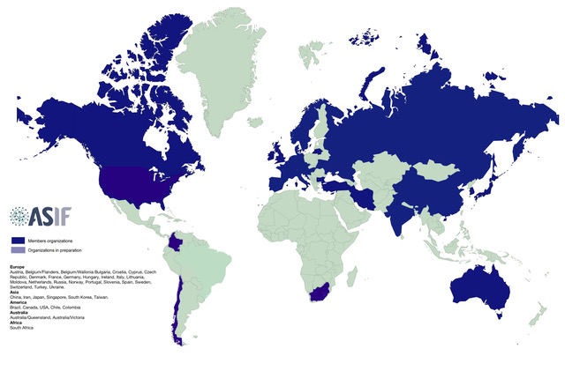
www.ASIF.info

Slide 4
Members
ASIF was established in 1988 to increase public awareness of Ankylosing Spondylitis and to disseminate knowledge of the disease around the world.
39 member organisations in 37 countries
New members in 2018, South Africa, Chile and Columbia
We hope to attract 6 new members countries with within the next year
www.ASIF.info

Slide 5
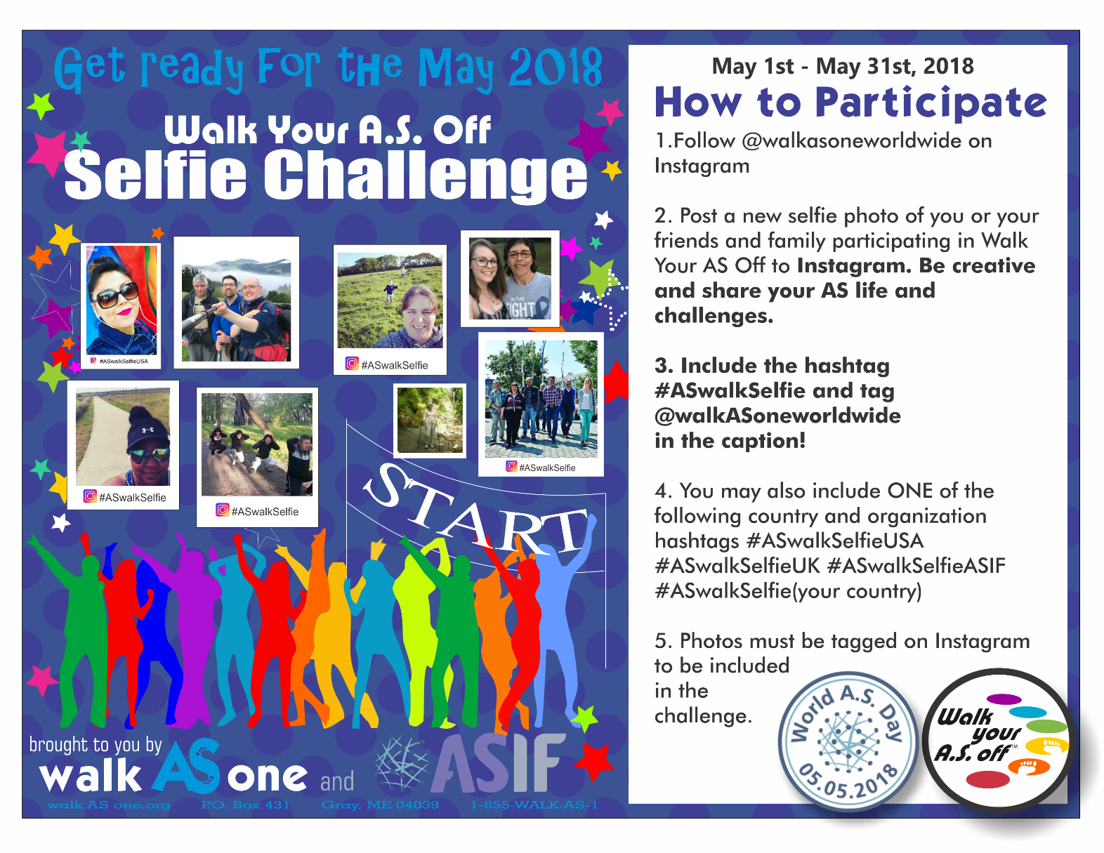
Walk Your AS Off 2018
www.ASIF.info

Slide 6
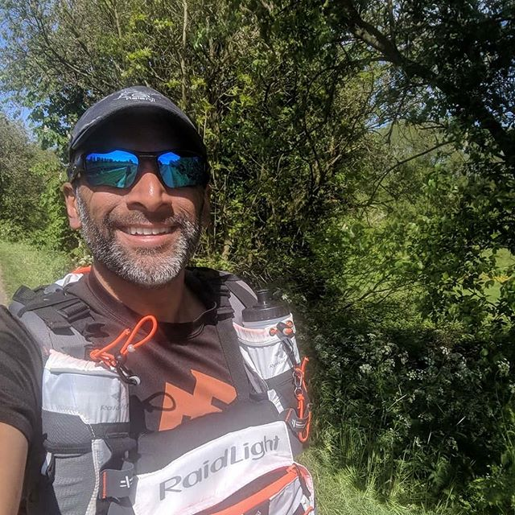
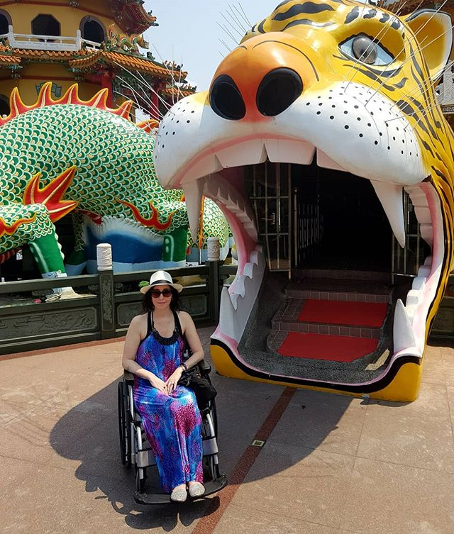
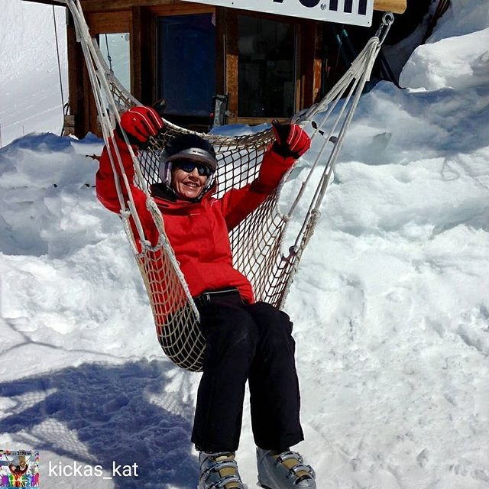
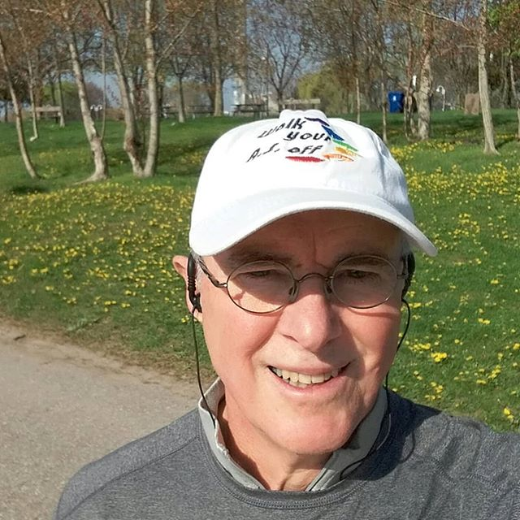
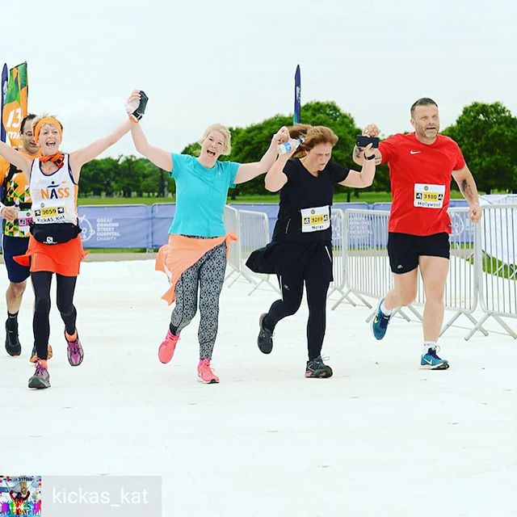
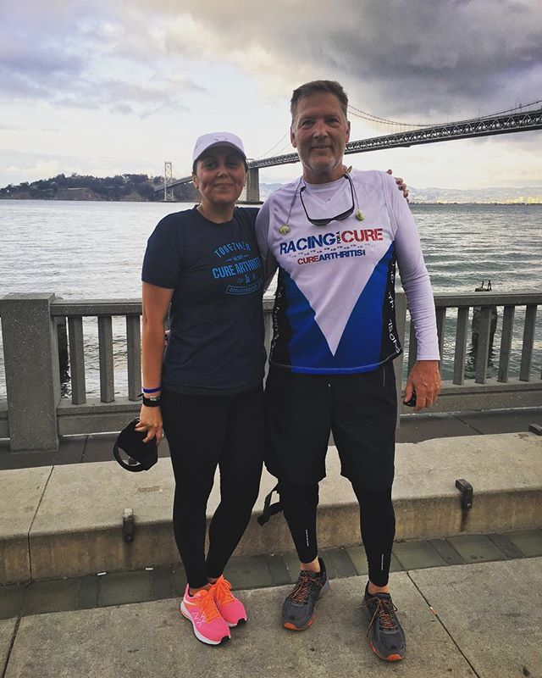
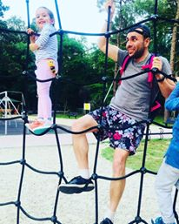
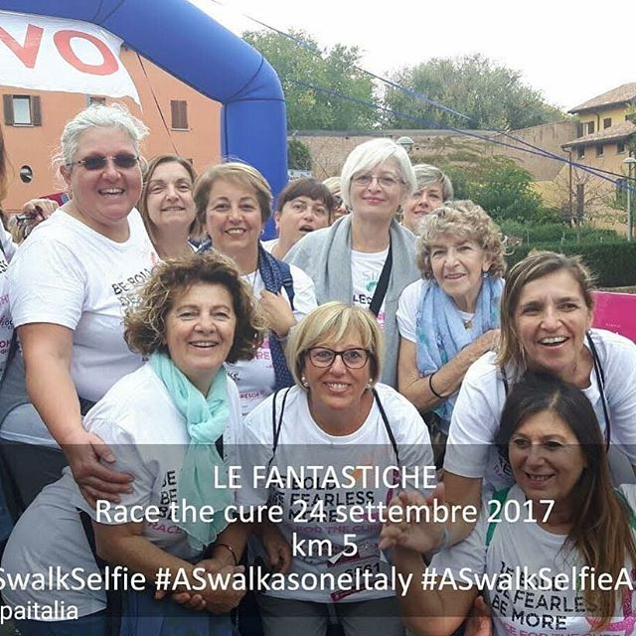
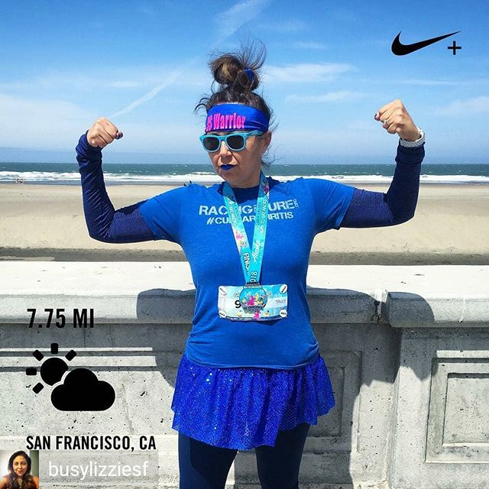
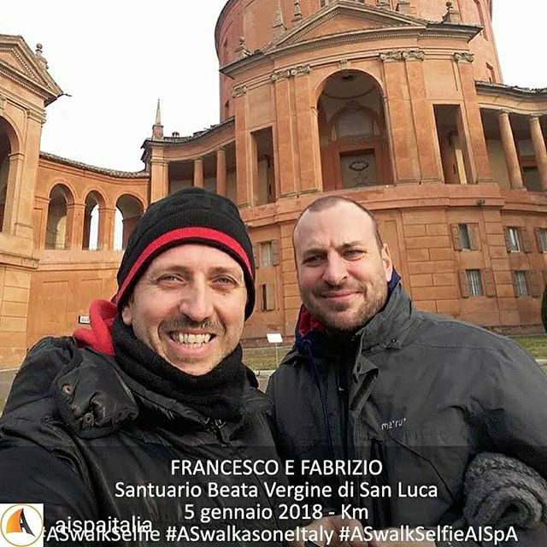
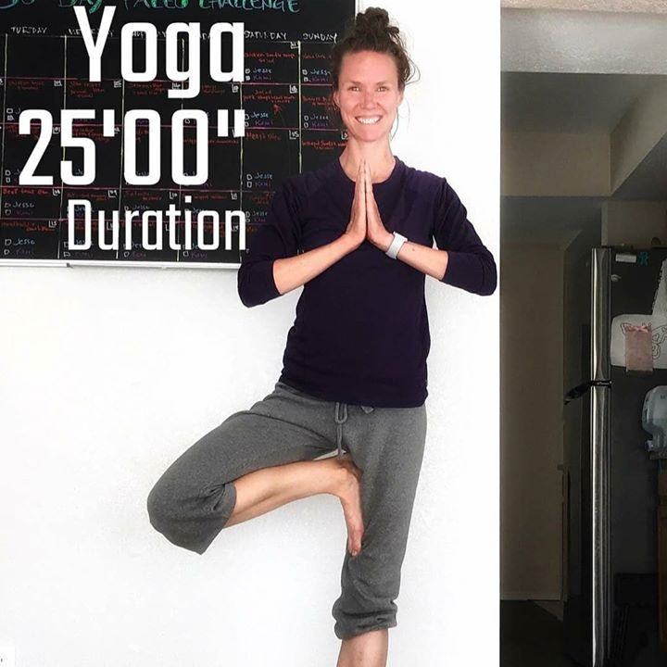
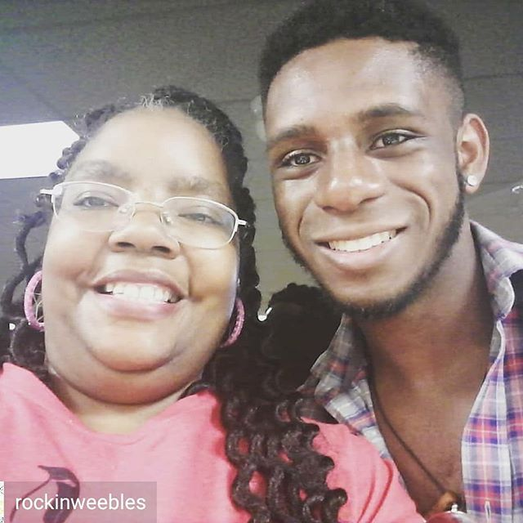
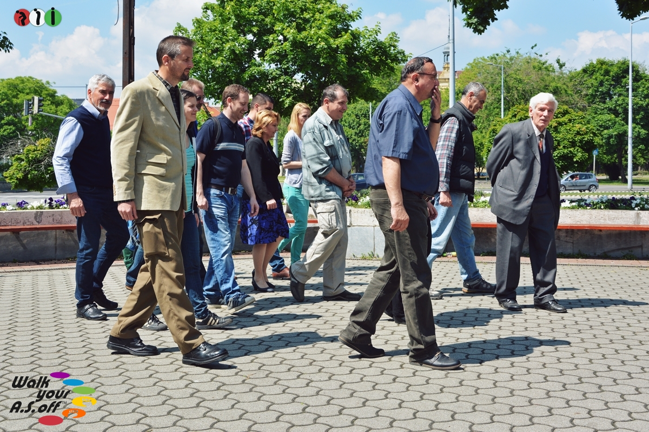
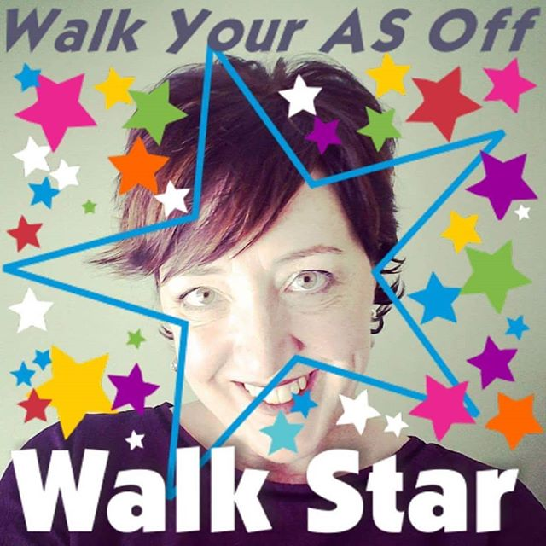
2018 Selfie Challenge photos

Slide 7



World AS Day 2018
Walk Your AS Off and the Selfie Challenge
Raj Mahapatra, ASIF Trustee made a video with Novartis for This AS Life

Slide 8
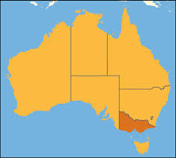
Ankylosing Spondylitis
Victoria Inc
Peer Support Group for people with Ankylosing Spondylitis who wish to improve knowledge of and ability to manage the condition. We are an affiliate of Move muscle bone and joint health in Victoria Australia.

Slide 9
AS Victoria Inc was founded in 2005 and currently has 80 members. Most members live around the capital city of Melbourne.
Our main activities are:-
Seminars/Webinars and exhibitions: Our event or joining in with Associates
Education of the Public and Health Professionals
Research: Patient Advocacy
Promotion of exercise e.g. warm water exercise, Nordic walking and Tai Chi
Peer Group meetings and interactions
Social Dinners and Lunches
Coffee and Chat meetings: group chat or one to one mutual support , exchange of ideas and experiences.

Slide 10
Our Group shares a number of goals and objectives for people and families living with Ankylosing Spondylitis.
We aim to provide the following:
Forum for the exchange of ideas and experiences.
Distribute AS information to patients and medical professionals.
Provide and co-ordinate educational information, events, workshops and seminars/webinars on AS.
Co-operate and interact with local, interstate, international Arthritis and peer support groups including participation in their events and activities.
Arrange social events and activities for our group members, their families and friends.

Slide 11
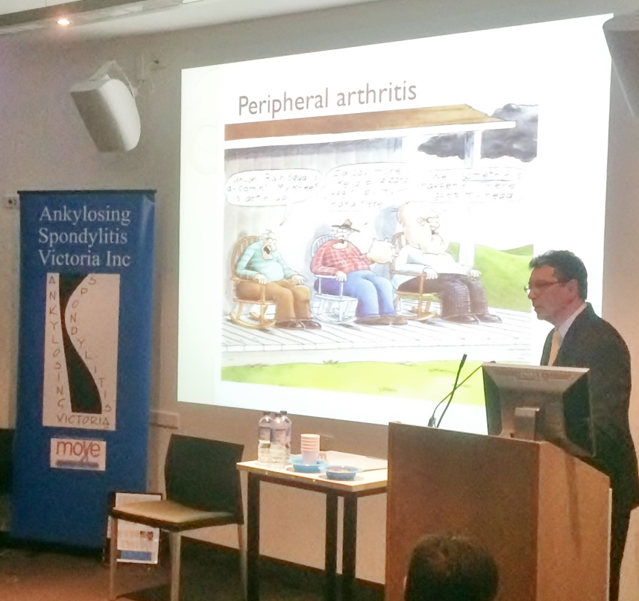
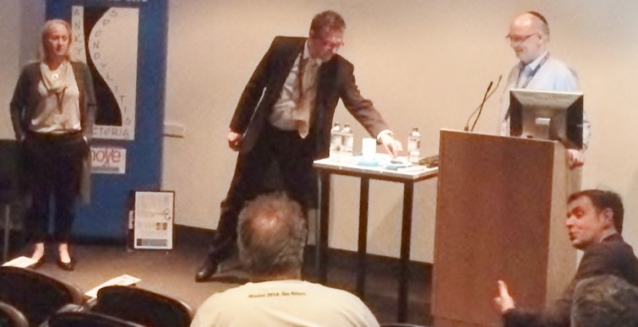
AS Victoria Inc Annual Seminar or Webinar is held each October. We have had speakers from the fields of Rheumatology, Ophthalmology , Gastroenterology , Endocrinology, Psychology, Exercise Physiology and various representatives from Move muscle bone and joint health.

Slide 12
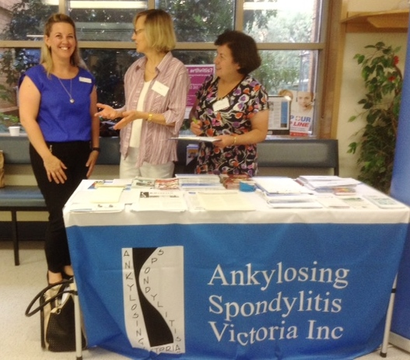
Information table at Austin Repatriation Hospital Outpatient Department This initiative saw us talking to patients and distributing AS fact sheets, AStretch newsletters, booklets and related information on the same day as the Rheumatology and Spondylitis Clinics.
Left to right –Tracey , Jan and Maria

Slide 13
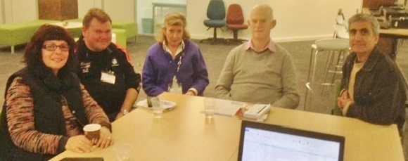
AS Patient Talks to Medical Students
Monash University Clayton Campus, talks to 300 first year medical students. Annual event since 2015,some 900 medical students have gained a better understanding of AS. We want them to carry this knowledge into their career as a GP and identify AS patients at an early stage.
Ankylosing Spondylitis Victoria Inc
PO Box 3166 Burnley North 3121
Australia ABN 66 915 454 826
www.asvictoria.org
asvicweb@gmail.com
www.facebook.com/asvicgroup
Our Speakers(L to R) - Ellen , Adam , Annie , Paul and Rasul awaiting their turn to address the students.

Slide 14
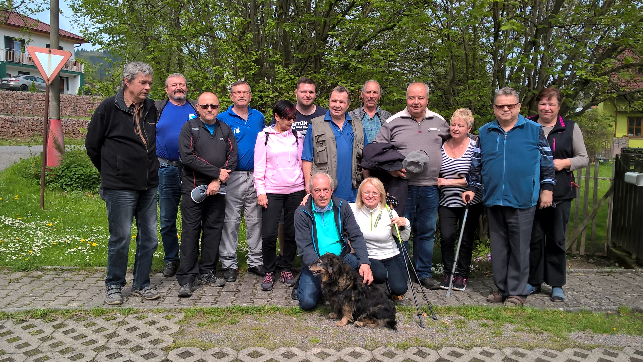
Celebrating AS World Day with the Czech AS Club “Klub bechtěreviků” with a walking trip joining the Walk Your A.S. Off initiative

Slide 15
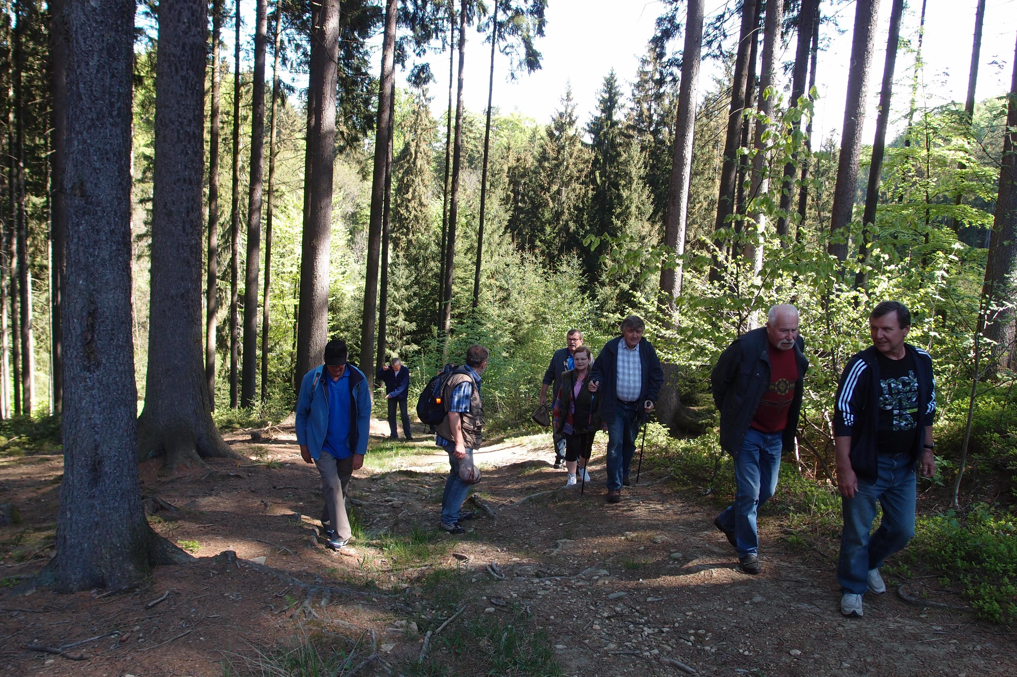
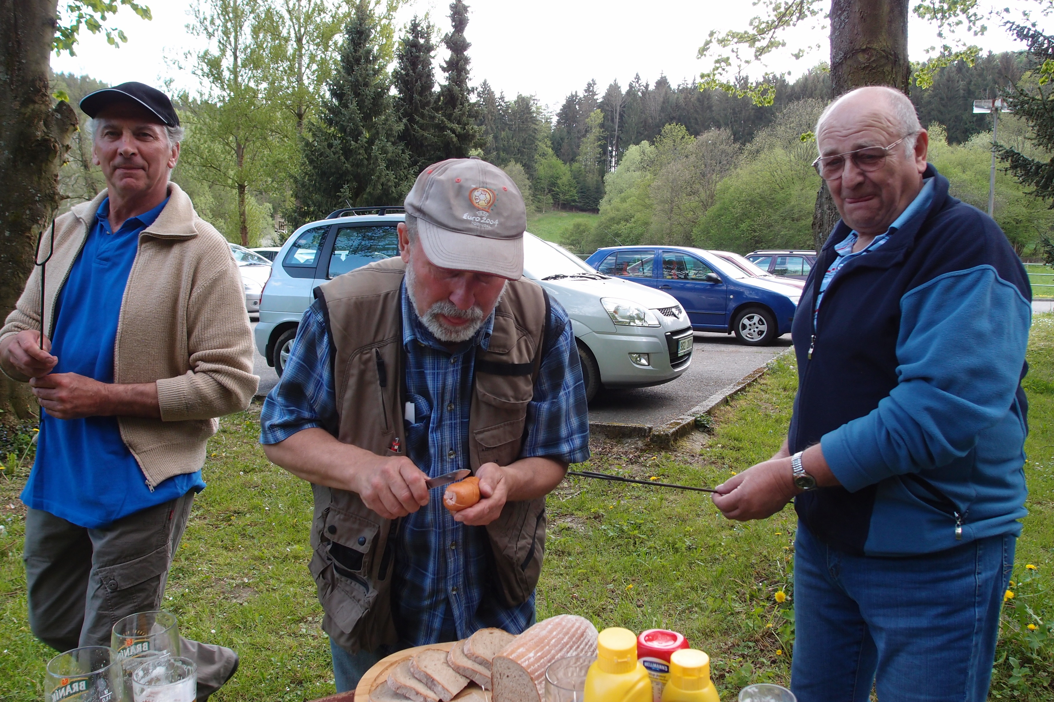
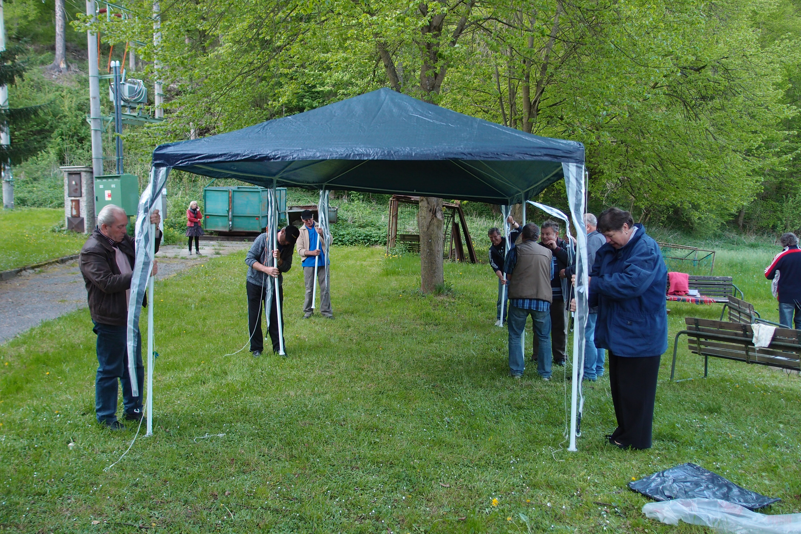
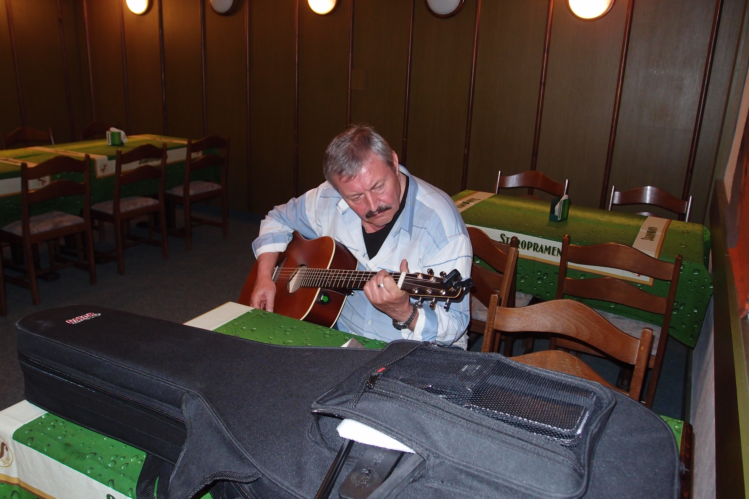
World AS Day in Czechia
The Czech Club celebrates the World AS Day by
weekend gathering:
  Annual board meeting
  Casual member gathering – walking trip,
  grill party and guitar singing

Slide 16


Deutsche Vereinigung Morbus Bechterew e. V.
The german network to help AS patients
help themselves!
Founded in 1980
Membership in January 2018: 15.000

Slide 17

Competence by Experience
Deutsche Vereinigung Morbus Bechterew e. V.
German self-help organisation for patients with ankylosing spondylitis or other forms of spondyloarthritis.
Chairman: Peter Hippe, Naumburg
Director: Ludwig Hammel, Schweinfurt
International Contacts: Martina Irrgang, Porta Westfalica
Scientific Editor: Prof. Dr. Ernst Feldtkeller, München
Quarterly Journal: “Morbus-Bechterew-Journal”
DVMB office: Metzgergasse 16, 97421 Schweinfurt, Germany
Phone (+49-9721) 22033, Mail:DVMB@bechterew.de
Notes:
1 Deckfolie

Slide 18
This is what
Deutsche Vereinigung Morbus Bechterew e. V.
offers to patients
Disease-specific group exercises weekly under professional supervision
Suitable group sports activities
Education and information by lectures and quarterly membership journal
Exchange of experiences among patients with different disease durations
Trusted advice in medical and legal questions
Self help by cooperation!
Notes:
16 DVMB bietet

Slide 19
Deutsche Vereinigung Morbus Bechterew e. V.
has got local groups in almost 400 communities
Weekly disease-specific group exercises
under professional supervision
Group sports activities suitable for patients
with the disease
Exchange of experiences among fellow patients
Lectures and discussions
Social activities
Counseling and emotional support
Notes:
17 Angebot Therapiegruppen

Slide 20
Regional support and cooperation:
Activities of our federal sections
Meetings with lectures and discussions
Symposia, seminars
Education of local group leaders
Financing of group activities
Press and public relations
Initiatives for founding new local groups
Notes:
19 Landesverbände

Slide 21
Comprehensive information, advice and help: Concentration of professionals in the office of the DVMB federal society
Advice for patients
Legal advice by our lawyer
Quarterly journal, booklets, seminars
Internet homepage, forum, newsletter
Contact with physicians, hospitals, assurances cos.
Press and public relations, political contacts
Cooperation with other patient associations
Tendering of DVMB research prize
Notes:
21 DVMB Bundesverband

Slide 22

Ankylosing spondylitis society in Norway
Bekhterev Norge
Consists of 11 local society

Slide 23

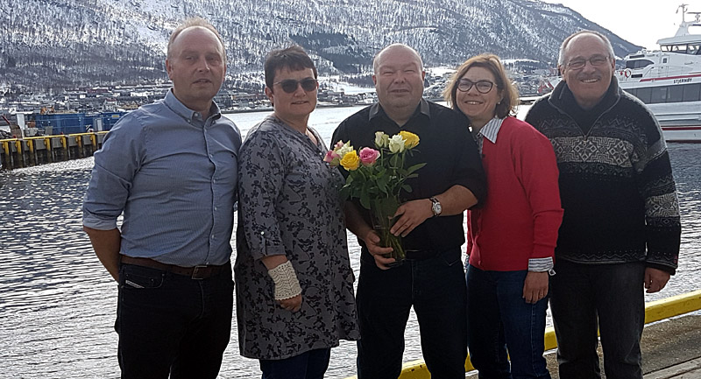
Board members
Hans Westerheim, Randi Moe, Odd Mikkelsen, Elisabeth Borud Kjønnø og Jon Hagfors

Slide 24
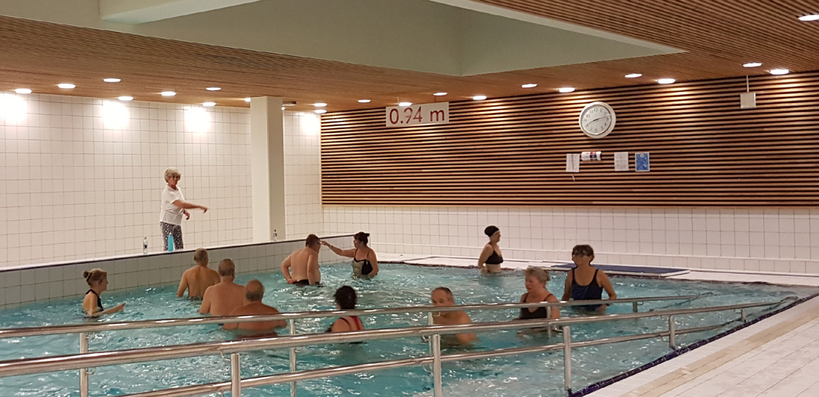
Exercise in pools is a very popular activity in Norwegian AS associations

Slide 25
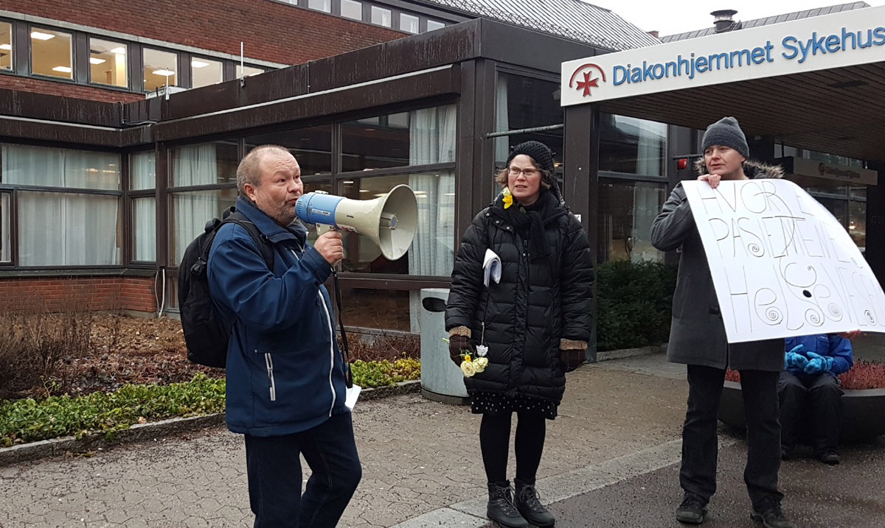
In Norway, the therapy pools are threatened with closure. Here from the campaign against closure of the pool at Diakonhjemmet hospital, which was unfortunately filled with concrete in march 2018.

Slide 26
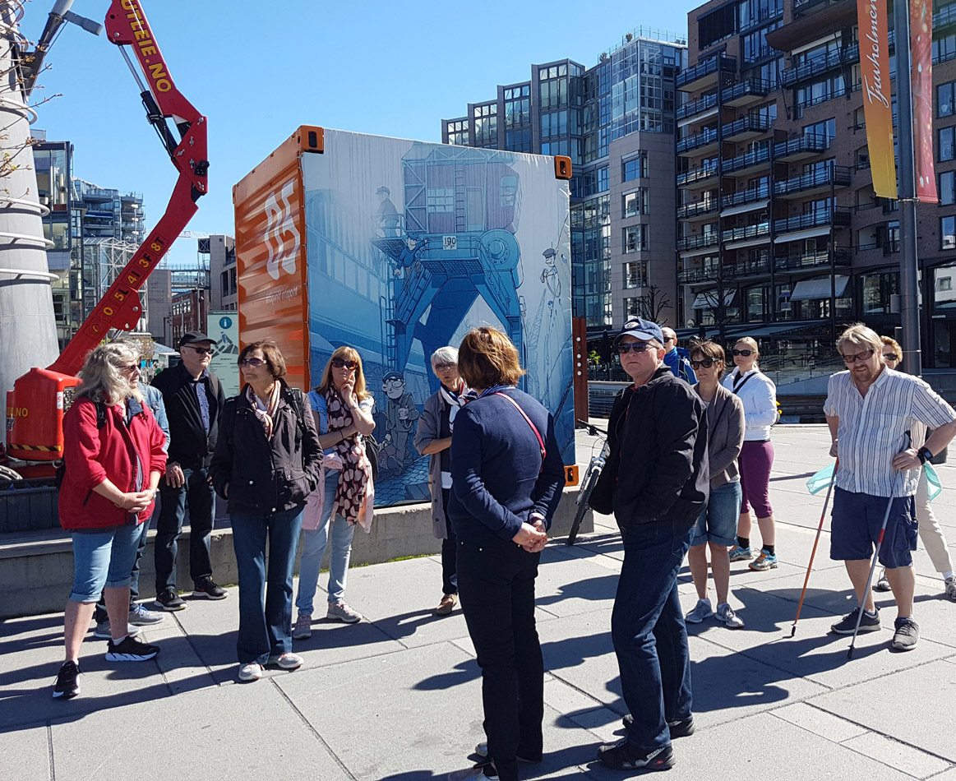
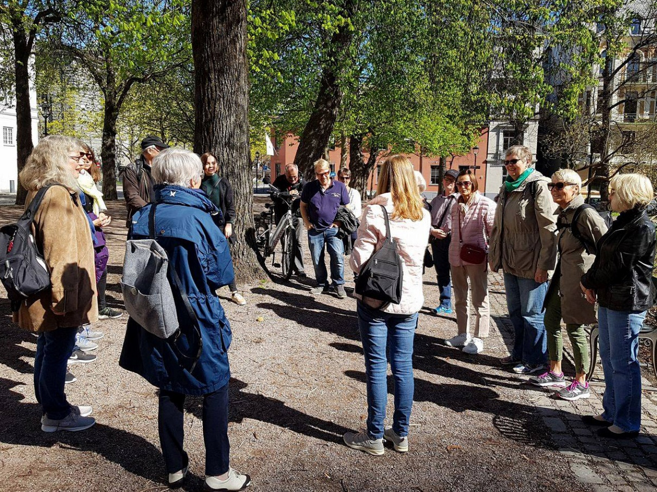
At World AS Day we walk ours AS off

Slide 27
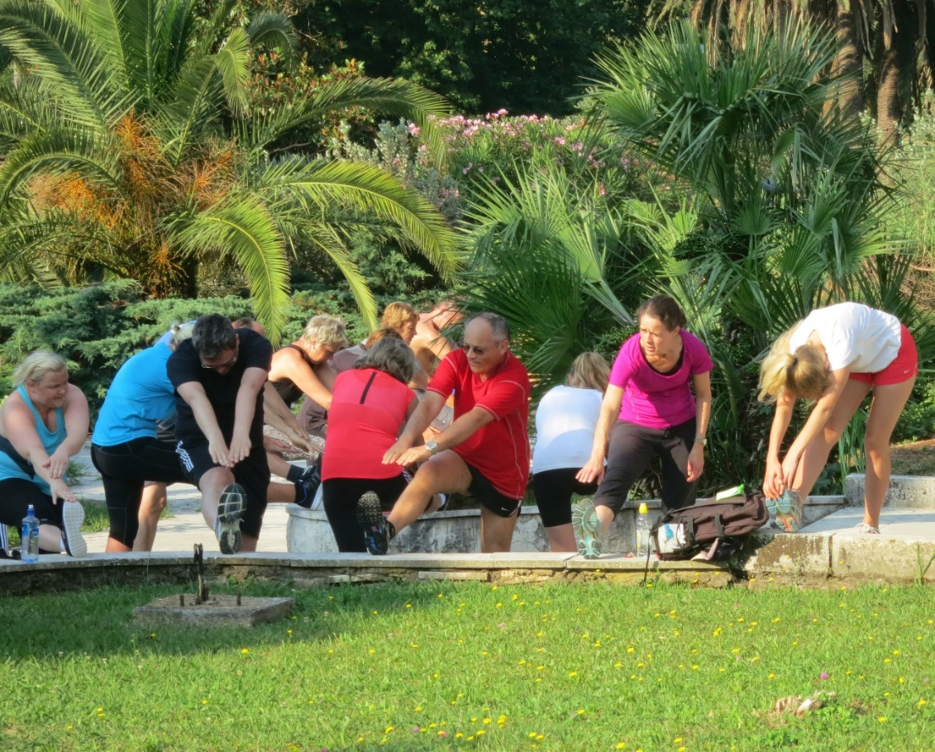
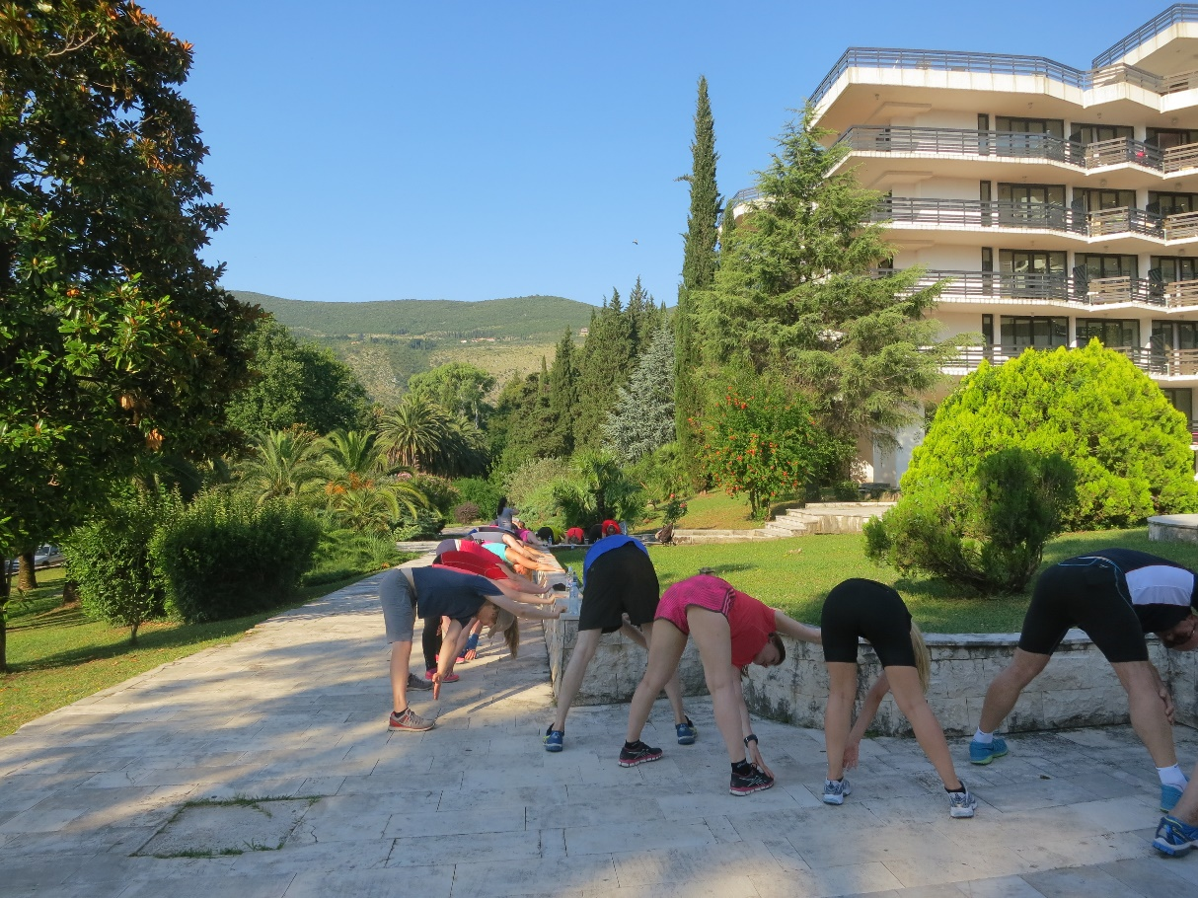
In Norway the government send AS patients to a warmer climate for treatment. AS Norway is fighting for retaining and improving of this treatment, which has proven good effect

Slide 28
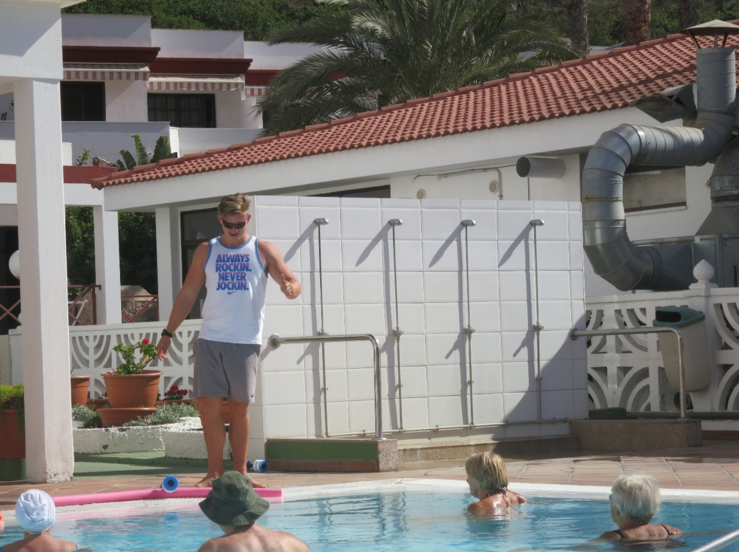
Climatic treatment
In the cold winter season, many AS - associations arranges tours to canary islands, or other destinations with warmer climatic conditions and where treatment is available

Slide 29

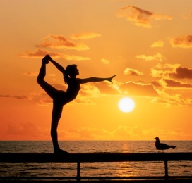
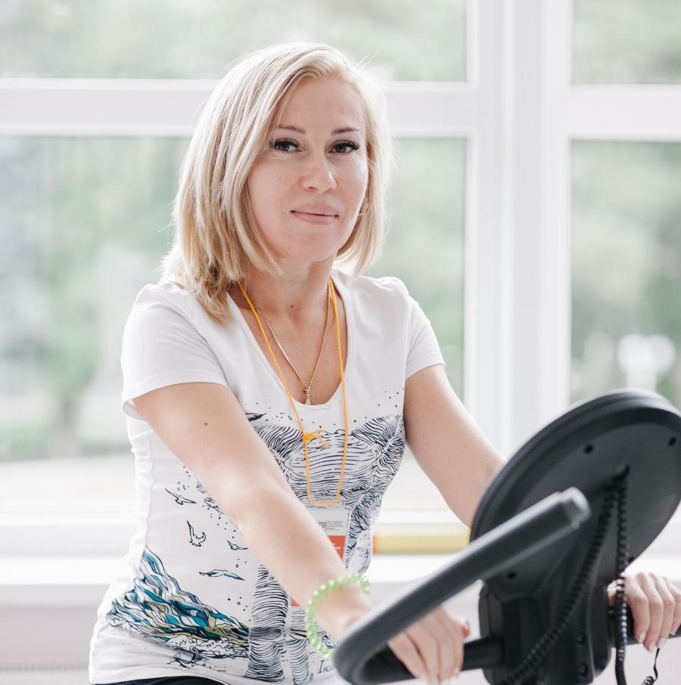
Общество взаимопомощи при болезни Бехтерева
Ankylosing Spondylitis Assosiation
www.bbehtereva.ru
Our objectives:
Medicine availability
Early diagnosis
Healthy lifestyle
Teaching patients
Self-management of the disease
Providing help and support for patients
Bechterew’s disease – the way of life
Not a sentence!

Slide 30
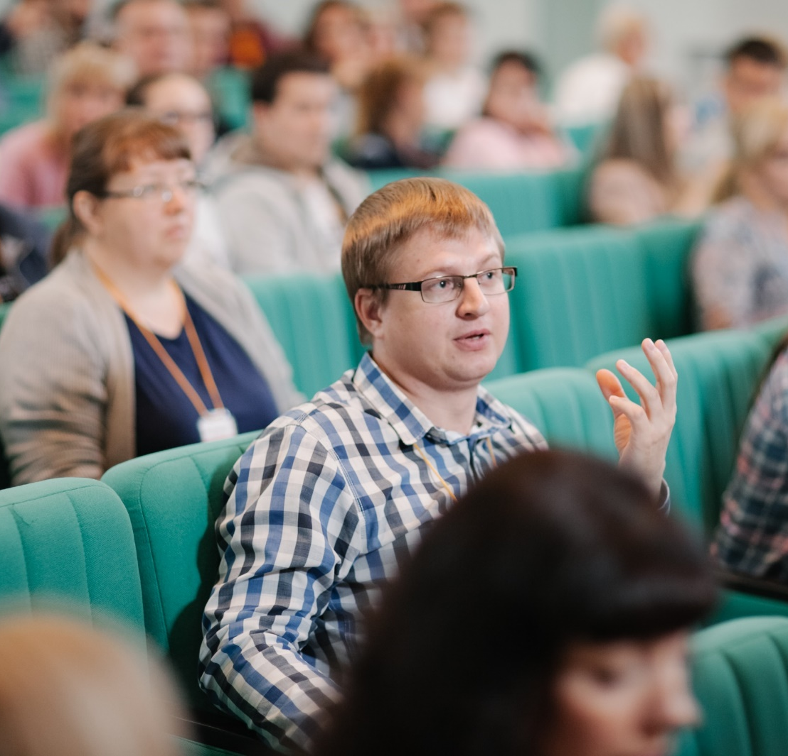
Общество взаимопомощи при болезни Бехтерева
Ankylosing Spondylitis Assosiation
www.bbehtereva.ru
18 regional departments in Russia
OUR MISSION:
Saving patients active way of life and ability to work through the development of prevention system and early diagnosis.
More than
9, 000 patients in social networks
OUR GOAL – improving the quality of patient life through:
the improving knowledge about disease,
the new methods and means of treatment,
social, mental and medical rehabilitation.

Slide 31
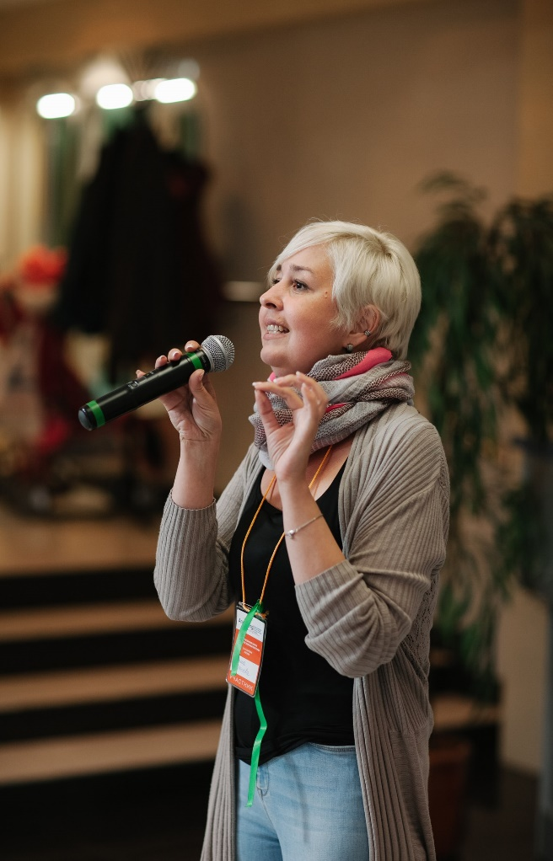
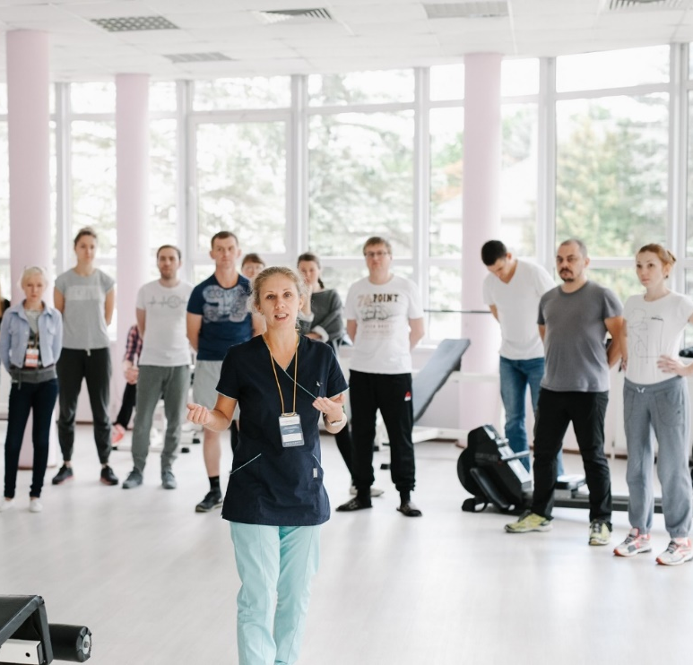
Общество взаимопомощи при болезни Бехтерева
Ankylosing Spondylitis Assosiation
www.bbehtereva.ru
OUR PROJECTS
SCHOOLS FOR PATIENTS
Knowledge and devotion to treatment
20 schools, 1,000 participants,
10,000 views on websites,
more than 5,000 regular subscribers
SCIENTIFIC RESEARCH
Participating in Bechterew’s disease studying and improving treatment methods.
EARLY DIAGNOSIS
Using advanced IT for constant control
of the disease on early stages.
ACTIVE SEARCH
Auto-search of patients messages on different websites – at least 1 saved life.
ACTIVE LIFE
Physical rehabilitation
5 series of video-course of exercise therapy
6, 000 DVDs for patients
Thousands of patients are engaged in exercise therapy

Slide 32
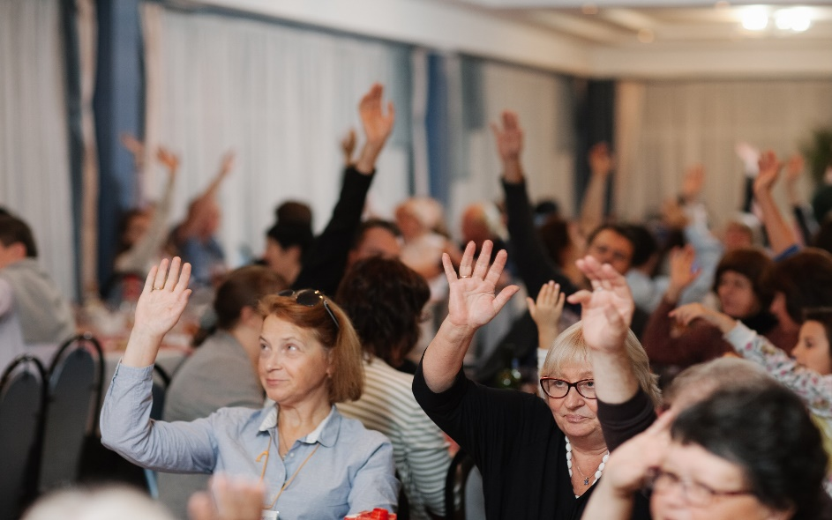
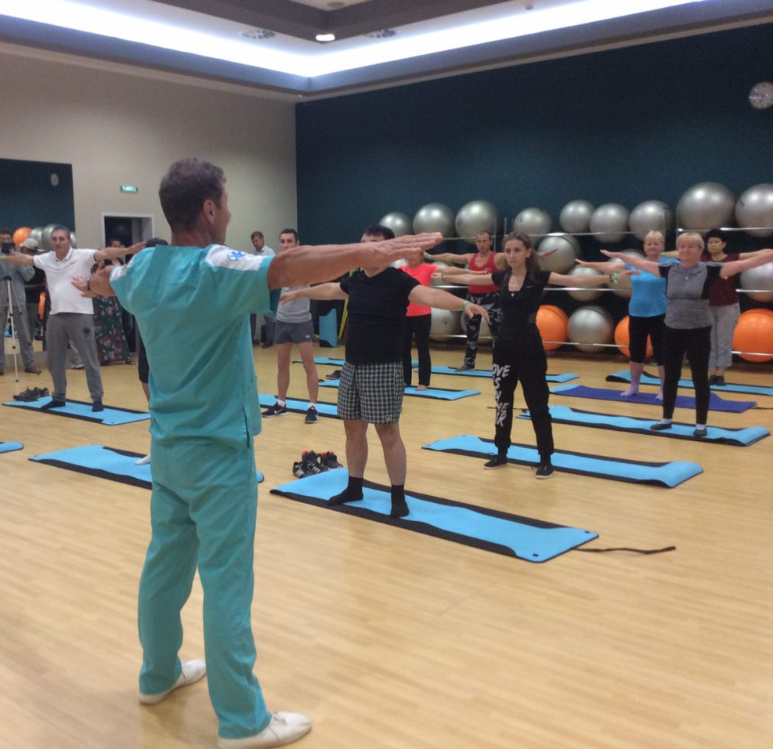
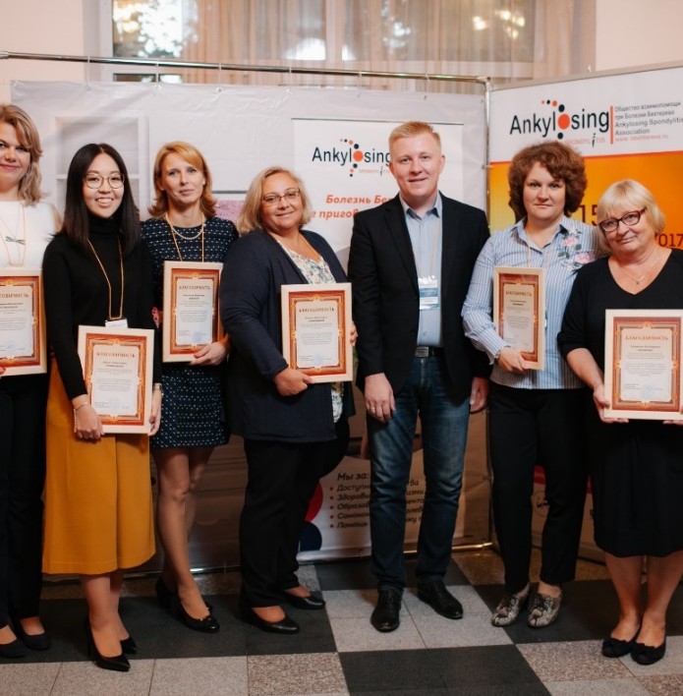

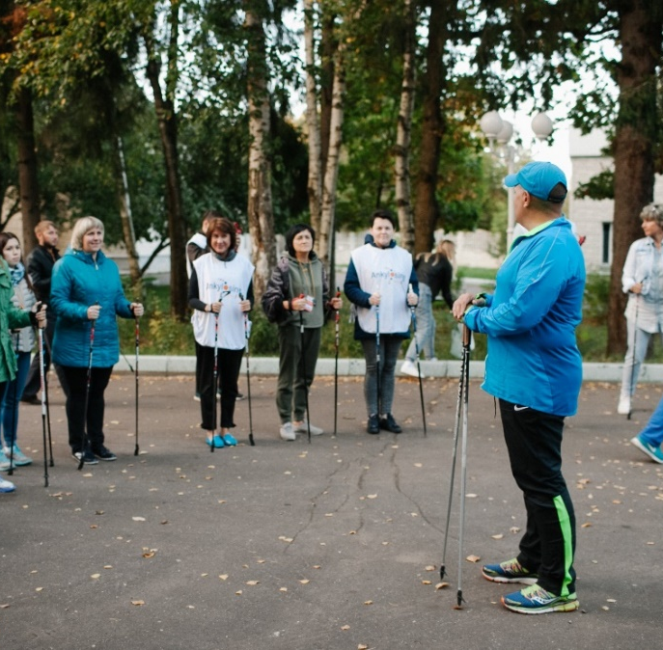

Общество взаимопомощи при болезни Бехтерева
Ankylosing Spondylitis Assosiation
www.bbehtereva.ru
CONTACTS
Aleksey Sitalo
President
+7 916 397 58 93
Ilya Dolotin
Executive director
+7 926 373 48 04
www.bbehtereva.ru
info@bbehtereva.ru

Slide 33

A
Leutschenbachstrasse 45, 8050 Zurich
+41 44 373 78 66
W
www.bechterew.ch/en
mail@bechterew.ch
P
M

Slide 34
About us
Founded in 1978 by Dr. Heinz Baumberger, Markus Schilling (†1983), Ruedi Tüscher (†2015) and Peter Oechslin
40 years anniversary
4‘242 members, including 3‘666 suffering from AS
6 board members suffering from AS
15 employees
Director: René Bräm
1
1
l 2018

Slide 35

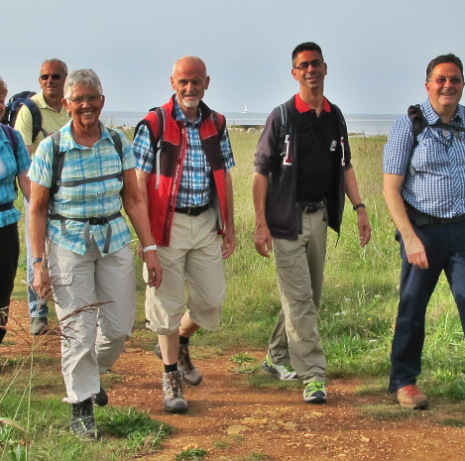


Activities
More than 80 local branches with weekly exercises
Various member events such as active week in Mallorca to stay in shape
Magazines «vertical» (4/ year), «move it» and further publications
Medical consulting
Newsletter (4/ year) and social media accounts
  Facebook: www.facebook.com/bechterew.ch
  Youtube: www.youtube.com/bechterewschweiz
2
l 2018

Slide 36


Website
Website www.bechterew.ch was redesigned in January 2018
Multiple stories about members suffering from AS
Explainer videos about different aspects of the disease
What‘s Ankylosing Spondylitis?
Therapy
3
l 2018

Slide 37
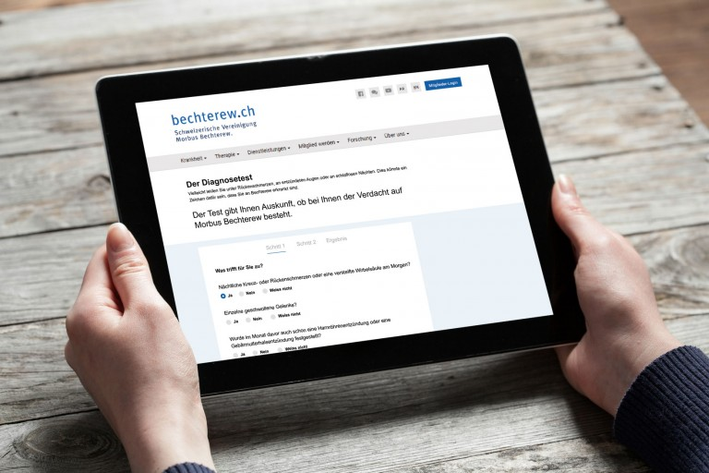
Backpain?
80‘000 people in Switzerland suffer from Ankylosing Spondylitis
Take the screening questionnaire to test whether you are likely to suffer from the disease: http://www.bechterew.ch/en/screening-questionnaire.html
4
l 2018

Slide 38
Thank you!
A
Leutschenbachstrasse 45, 8050 Zurich
+41 44 373 78 66
W
www.bechterew.ch/en
mail@bechterew.ch
P
M

Slide 39
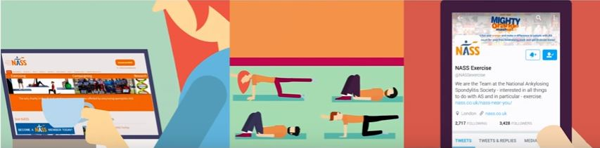
UK
National Ankylosing Spondylitis Society
NASS

Slide 40
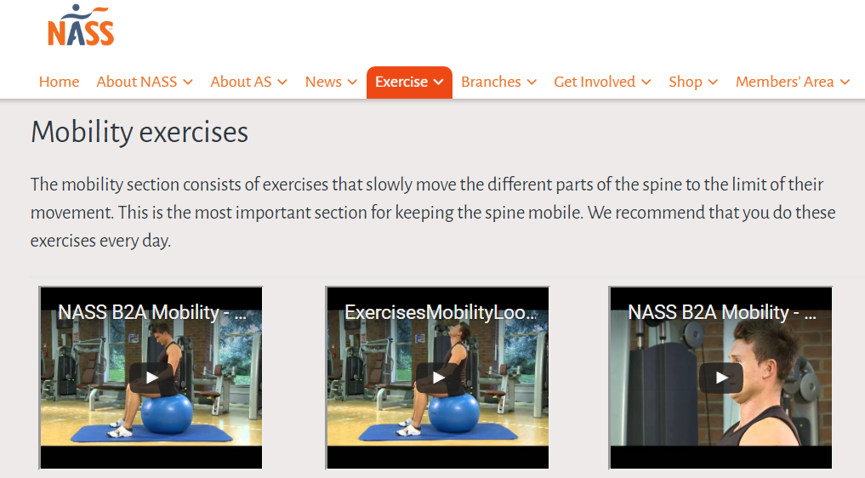
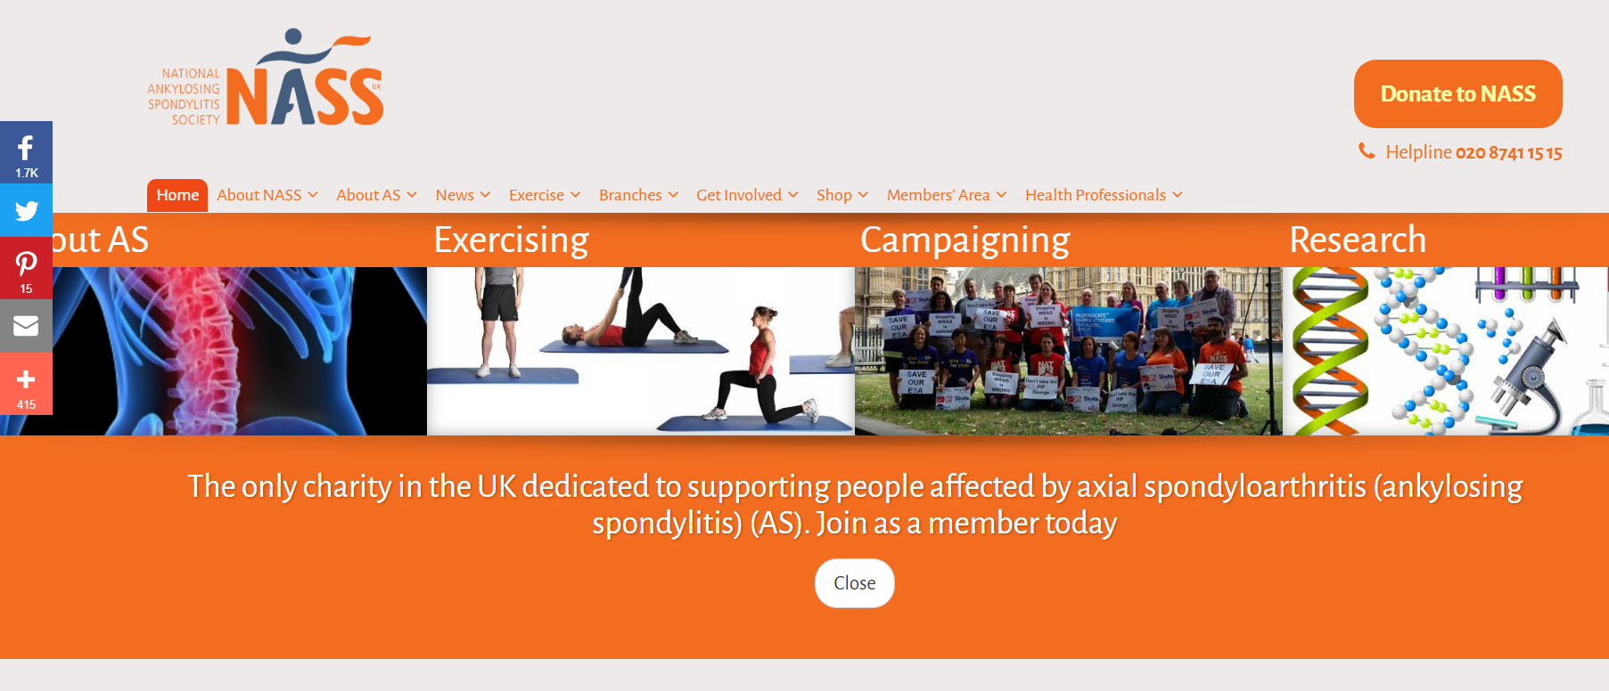
Website
Over 300,000 visitors each year
www.nass.co.uk
Getting my diagnosis
What is AS?
Managing my AS
NICE Guideline
Exercise
Research
Campaigning
NEW website for 2018
Notes:
We have a very extensive and information website which is regularly updated. We developed the current website in 2011, although the information is regularly updated. Although we have mobile optimised it and added additional security we will be developing and moving to a new website in 2018. We are keen to capture user experiences during the redevelopment phase so the finished website meets users needs so please do get involved and contribute to this process in the New Year

Slide 41

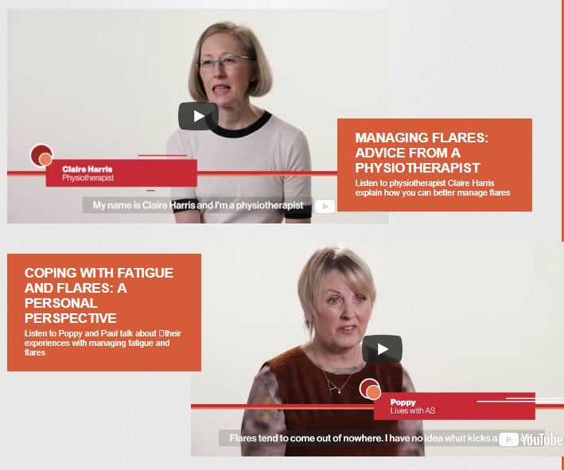
Videos
You Tube Channel (National Ankylosing Spondylitis Society)
2016
Leaving room for your golf balls
Top tips for managing your AS
Checking your posture
2017
What is AS?
Ankylosing Spondylitis – Not just back pain
Managing your AS
2018
9 videos on how AS is managed with GP,
rheumatologist, physiotherapist and
people with AS
Notes:
We know lots of people, especially the younger demographic like to obtain information through videos so we started to develop a range of videos in 2016. These initially concentrated more on wellbeing. Our ‘leaving room for your golf balls’ video was developed by OT Clare Clark and covers the importance of prioritising in your daily life. It really applies to anyone, not just people with AS.
In 2017 we received a hands off education grant from AbbVie to produce a series of videos explaining AS.
What is AS was released on World AS Day in May 2017. To date had 9,968 views. It covers the basics of AS.
Ankylosing Spondylitis – Not just back pain was released in August 2017. To date had 8,445 views. It covers all the extra-articular manifestations of AS along with issues like rib pain and foot problems
Managing your AS was released on World Arthritis Day in October 2017. To date had 2,524 views. It covers the management of AS including physiotherapy, NSAIDs and biologic medication plus stopping smoking.

Slide 42
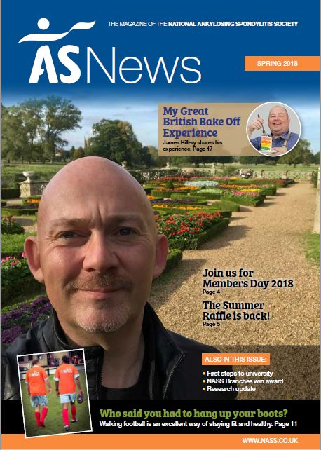




Publications
Over 30,000 publications sent out each year
Guidebook
Guide to Biologic therapy
Managing your AS at Work
Managing AS Flares
Factsheets (Driving, Fatigue, Uveitis)
AS News magazine
Benefits guides
Notes:
We have a range of NASS publications which HCPs can order free of charge for their AS patients. The most recent is our Guide to Biologic Therapy which replaces our Guide to anti TNF therapy. It was published in June 2017.
AS News is our twice yearly magazine for NASS members.
We have a professional subscription to a website called Benefits & Work which provides detailed guides to applying for and appealing disability benefits including Personal Independence Payment (PIP) and Employment and Support Allowance (ESA). Under the terms of the copyright we can only offer these to Members. They are very popular as people do feel these benefits are complex.

Slide 43




Supporting exercise
Back to Action (Part 2 – Gym balls & free weights)
Fight Back DVD
90+ NASS branches around UK offering weekly physiotherapy
Notes:
We have two exercise guides – Back to Action parts 1 & 2. These are available as hard copies in our shop, online videos on our You Tube channel and as a free App. They are aimed at people who feel more confident at exercising by themselves in the gym
Our Fight Back DVD was released a number of years ago and re-published in 2012. We will probably aim to replace it over the next couple f years. It’s aimed at people with more advanced AS whho want to exercise at home and comprises 6 exercise programmes with 35 individual exercises including hip safe exercises.
Our NASS branches aim to offer regular supervised physiotherapy sessions around the UK.
As an example, our Leicester Branch offers physiotherapy and hydrotherapy every Monday evening at the Leicester General Hospital.

Slide 44

ASone, a portal for young people living with AS
www.asone.nass.co.uk
Launched June 2017
Creating a community through website and social media
Articles covering a range of young people’s issues
Guest bloggers input – voice of young people with AS, platform to share experiences
Notes:
ASone is a website which aims to bring young people together BUT we don’t specify what ‘young’ means. If people find it useful to read about the experiences of others and interact with the site we are happy to have them.
Do suggest to younger people you see that they could be in touch and share their experiences.

Slide 45



ASone social media
Facebook
facebook.com/NASS.Asone
Twitter
@NASS_Asone
Instagram
www.instagram.com/nass_asone/

Slide 46

SPONDYLITIS ASSOCIATION
OF AMERICA
Our Mission
To be a leader in the quest to cure ankylosing spondylitis and related diseases, and to empower those affected to live their lives to the fullest

Slide 47
Our Goals
A world free from the pain and disability of Axial Spondyloarthritis (AxSpA)
Educating & empowering the newly & previously diagnosed
Advocating for shorter time to diagnose for better outcomes
Supporting Research – advancing prevention & remission
Trusted NGO Partner: 35 Years of Accomplishments

Slide 48




Patient Support Program Highlights
  Spondylitis Plus Magazine, Toll-free Information Line 800-777-8189
  www.spondylitis.org >5,000+ Pages of Information
  Educational Pamphlets, DVDs and Audio CDs
  Patient Education Seminars
  Partnered with Dan Reynolds from Imagine Dragons and Novartis for video series This AS Life Live (TASLL)

Slide 49










Patient Support Program Highlights (cont.)
  teens.spondylitis.org S.W.I.F.T.
  (SpA Web Info For Teens)
  Educational Podcasts, Webinars, eSUN Newsletter
  Connections, forums.spondylitis.org
  Social Networks - Facebook, LinkedIn, Twitter, YouTube, Meetup, Instagram & Pinterest

Slide 50


Patient Support Program Highlights (cont.)
  Nationwide, Free Educational Seminars
  First Responder Accredited Training Video
  Development of the SAA Screening Tool for Ankylosing Spondylitis (Backpaintest.org)

Slide 51

Patient Support Program Highlights (cont.)
38 Educational Support Groups in
25 States and Growing…

Slide 52
Advancing Science
Award at least one SAA/Bruckel Early Career Investigator Award Annually
Supported by the SAA, the first ever epidemiology study data conducted by the CDC in the US
“AS Life Impact Study” polling those affected about onset of symptoms, diagnosis, treatments, medications and quality of life issues
SAA oversaw the nationwide recruitment of patients and families for the TASC Genetic Study
Conducted Unmet Needs Conferences on SpA at NIH

Slide 53
Awareness & Treatment
U.S. ankylosing spondylitis awareness campaigns
Partnered with ACR & SPARTAN to develop Ax SpA Treatment Guidelines in the US in 2015 and updating in 2018
Provides a CME training program in MRI for Radiologists
in Early Detection of Spondyloarthritis
Produced the first-ever training video for emergency first responders
Launched BackPainTest.org, the first and only validated Screening Tool for Ankylosing Spondylitis

Slide 54
Patient Support Program Highlights
  Spondylitis Plus Magazine, Toll-free Information Line 800-777-8189
  www.spondylitis.org >5,000+ Pages of Information
  Educational Pamphlets, DVDs and Audio CDs
  Patient Education Seminars
  Partnered with Dan Reynolds from Imagine Dragons and Novartis for video series This AS Life Live (TASLL)

Slide 55


Slide 56


Slide 57


Slide 58


Slide 59




Slide 60


Slide 61


Slide 62


Slide 63


Slide 64


Slide 65


Slide 66


Slide 67


Slide 68


Slide 69


Slide 70




Slide 71



Slide 72


Slide 73


Joint action of AS patiens
LITHUANIA
Notes:
73

Slide 74


Association of patients suffering from Bechterev Disease “Judesys”.
Lithuania has a population of around 2,9 mil.
6.000 to 9.000 have AS…
The association was established in 2009
Why was it established?
  Because a lone soldier is not an army
  To be heard by government institutions
  To help each other
Around 150 active members
The association acts as a single unit, with coordinators in the main cities
Notes:
74

Slide 75

Activities. We organise conferences twice a year: 2018 was in rehabilitation clinic
Notes:
75

Slide 76

Activities that we participate in.
Summer camp
For a single weekend in summer we all gather at a summer camp, where we listen to lectures and seminars on healthy living, among other activities:
Notes:
76

Slide 77

Activities that we participate in. Summer camp
Art therapy:
Notes:
77

Slide 78

Activities that we participate in. Summer camp
  Start of the day with a strech and a work out:
Notes:
78

Slide 79

Activities that we participate in. Summer camp
  We don't shy away from extreme challenges – a hike through the swamp:
Notes:
79

Slide 80
Future goals
Establish a day support center (especially for those newly diagnosed)
  We would provide counseling with a psychologist
  Sessions with a kinesitherapist
  Massage
  Tutoring of family members on how to provide help to the patiens.
  Longer summer camps – up to a week long, including a course on healthy living: diet, work outs, yoga, etc.

Slide 81


Social media
  Official Facebook profile of
  organization Judesys
  Closed Facebook group where member of our organization could share they experience or discuss about relevant issues.

